Slide 1


Java for Second-Year Students: From "Hello World" to Confident Coder
Welcome to your journey into Java! Get ready for a fun, meme-filled ride from basic syntax to advanced concepts, with practical GitHub links to guide your way. Let's make learning Java an adventure!

Slide 2
Java Basics: Syntax & Structure
Every Java program is built around the concept of classes. Think of a class as a blueprint for creating objects. Your program's execution begins within a special method called main.
public class HelloWorld {
public static void main(String[] args) {
System.out.println("Hello, Java!");
}
}
This simple structure is the entry point for all Java applications. Understanding it is the first step to mastering Java. Pay close attention to syntax – Java is case-sensitive and relies on precise punctuation.
Meme moment: "Java: where naming things requires at least five words and three design patterns."

Slide 3
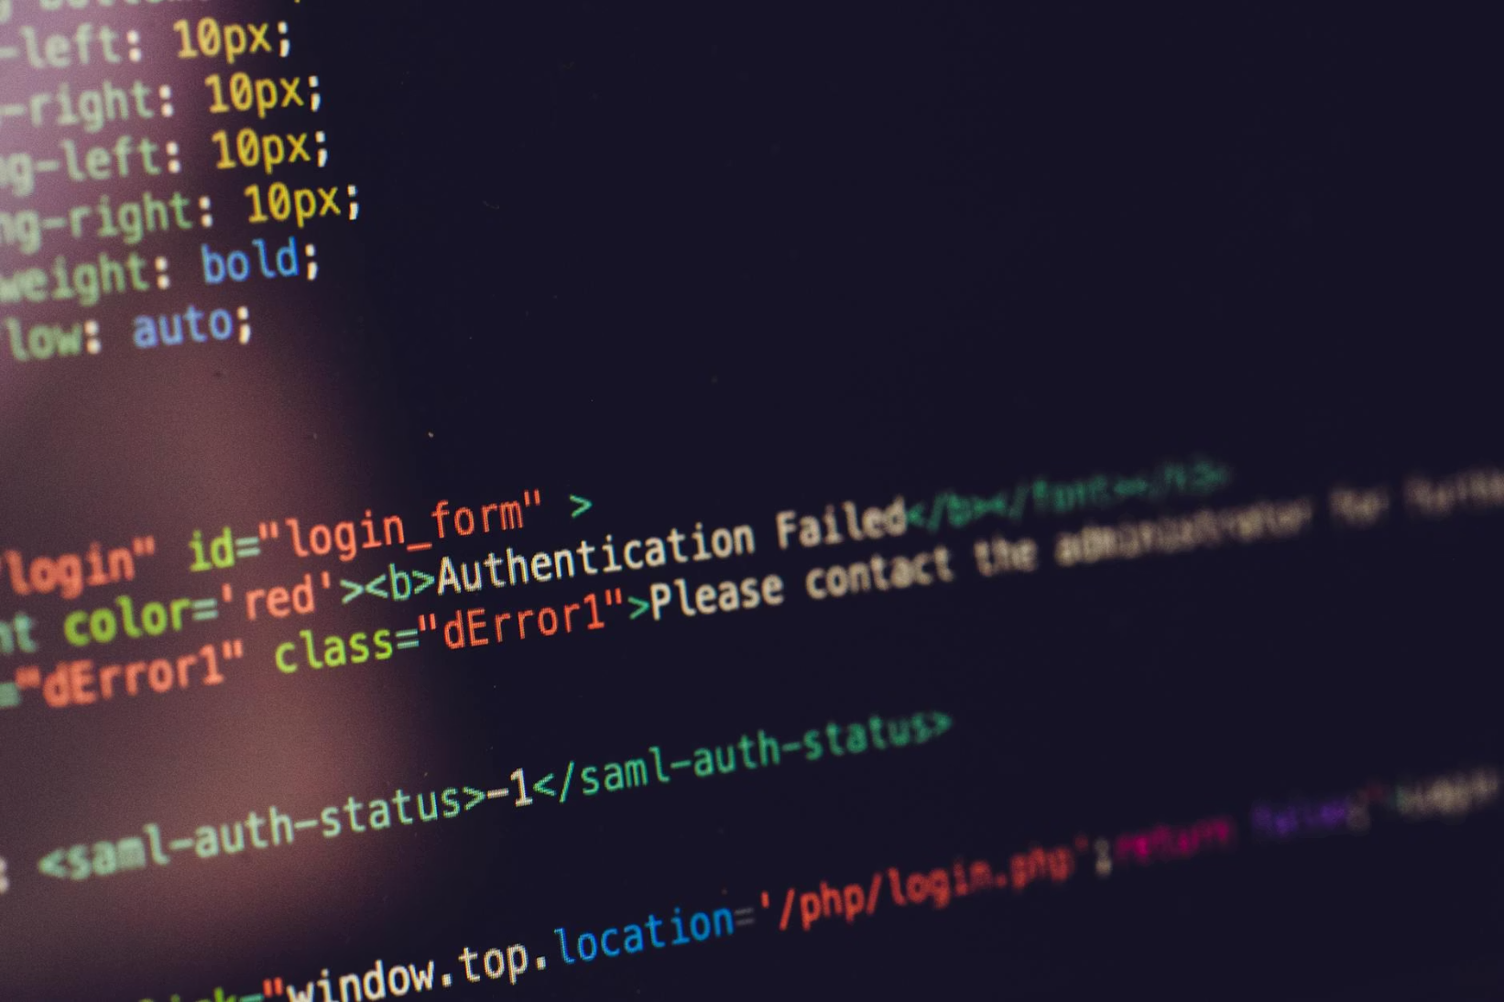

Variables, Data Types & Control Flow
Variables are containers for storing data. Java provides several primitive data types:
int: for whole numbers (e.g., 5, -100)
double: for floating-point numbers (e.g., 3.14, -0.001)
boolean: for true/false values
char: for single characters (e.g., 'A', '7')
Control flow statements dictate the order in which your code executes. Master these to make your programs dynamic and responsive:
if-else: conditional execution
switch: multi-way branching
Loops (for, while): repeating blocks of code
Meme moment: "When you forget a semicolon and your code screams louder than you."

Slide 4


Object-Oriented Programming (OOP) Essentials
OOP is the cornerstone of Java, a paradigm that organizes software design around objects rather than functions and logic. It's about modeling real-world entities and their interactions.
Classes & Objects
Blueprints and instances. Defines behavior and attributes.
Inheritance
Allows classes to inherit properties from other classes, promoting code reuse.
Polymorphism
Objects can take on many forms, enabling flexibility and dynamic behavior.
Encapsulation
Bundles data and methods that operate on the data within a single unit, hiding implementation details.
Meme moment: "Java is so verbose it practically documents itself — whether you want it or not."

Slide 5
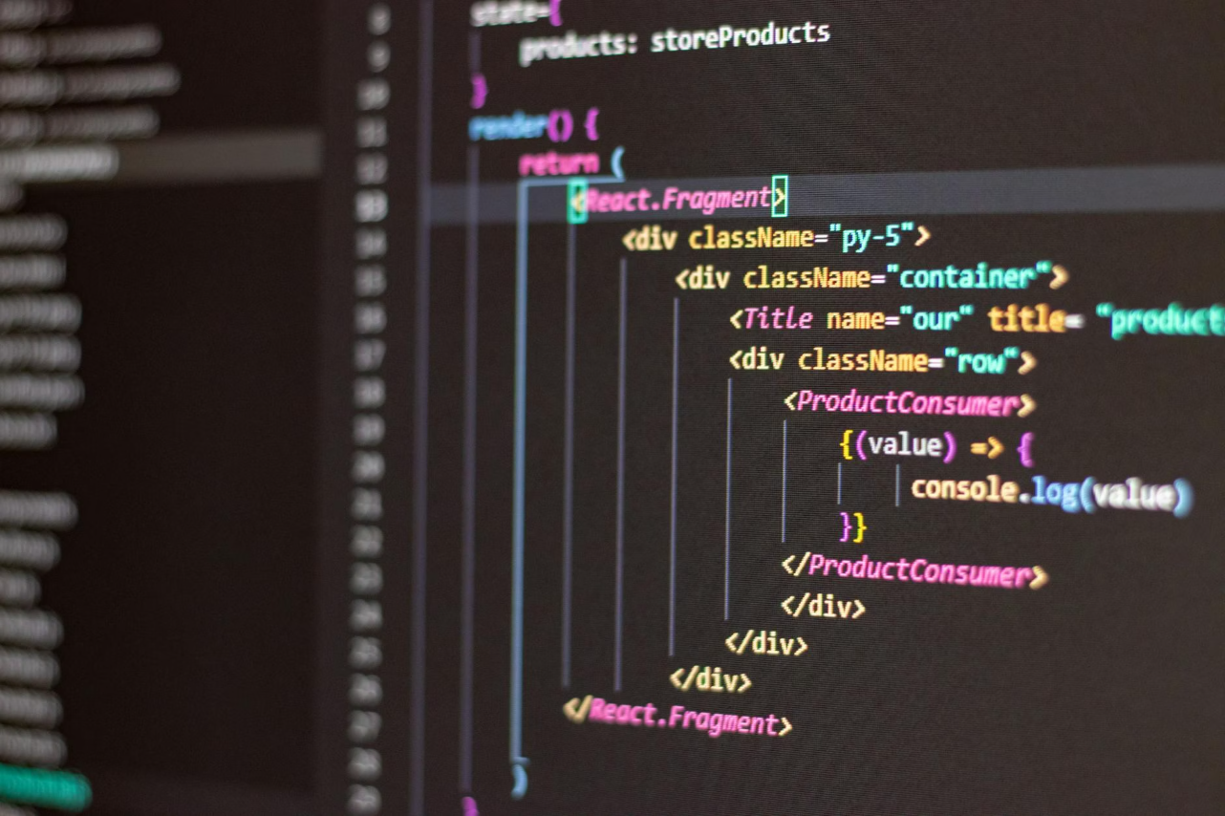
Methods, Constructors & Overloading
Methods define the actions that objects can perform. They are reusable blocks of code that enhance modularity and readability.
Constructors are special types of methods used to initialize new objects. They share the same name as the class and are invoked when an object is created using the new keyword.
Method overloading allows you to define multiple methods within the same class that have the same name but different parameters (number, type, or order). This provides flexibility and improves code elegance by allowing a single method name to perform similar operations on different data inputs.
Meme moment: "Explaining to your boss why JVM needs more RAM than your gaming PC."

Slide 6





Collections & Generics: Handling Data Like a Pro
The Java Collections Framework provides a unified architecture for representing and manipulating collections, allowing you to store, retrieve, and process groups of objects efficiently. Generics bring type safety to these collections, preventing runtime errors and making your code cleaner and more robust.
Lists
Sets
Maps
Generics
Ordered collections allowing duplicate elements (e.g., ArrayList, LinkedList).
Unordered collections that do not allow duplicate elements (e.g., HashSet, TreeSet).
Stores key-value pairs, where each key is unique (e.g., HashMap, TreeMap).
Enables type-safe collections by allowing types to be parameters for classes and methods.
Meme moment: "Java 8 is the ghost haunting every company project in 2026."

Slide 7




Exception Handling & Debugging
Even the best code can encounter unexpected situations. Exception handling is Java's mechanism for dealing with these runtime errors gracefully, preventing your program from crashing. The try-catch-finally block is your primary tool.
Try
Catch
Finally
Code that might throw an exception.
Handles specific exceptions thrown in the try block.
Code that always executes, regardless of an exception.
You can also define and throw your own custom exceptions to better manage application-specific error scenarios. Debugging is the art of finding and fixing these issues.
Meme moment: "Debugging Java code: 90% waiting, 10% questioning your life choices."

Slide 8

Modern Java Features to Boost Confidence
Java has continuously evolved, introducing powerful features that make development more concise, efficient, and enjoyable. Embrace these modern additions to write more expressive and maintainable code.
Lambda Expressions & Streams API
Records
Pattern Matching
Enables functional programming, making code more readable for data processing.
Concise syntax for data-carrying classes, reducing boilerplate.
Simplifies conditional logic and type casting.
Virtual Threads
Lightweight threads that simplify concurrent programming (Java 21+).
Meme moment: "Java’s weight loss journey: from bulky boilerplate to sleek and efficient."

Slide 9


Your Java Journey Starts Now!
You've seen the fundamentals and glimpsed the future of Java. Now, it's time to apply what you've learned. The best way to become proficient is by doing!
Practice daily: Consistency is key to mastering any skill.
Read code: Explore open-source projects and learn from others.
Build projects: Start small, then tackle more complex challenges. The GitHub repos are your sandbox!
Meme moment: "Java: the language that’s verbose, powerful, and oddly comforting."
Final tip: Keep calm and Java on! Every error is a learning opportunity.

